Slide 1

Content: aka.ms/mkedevdays
#Azuredevdays

Slide 2
Azure App Service
Frank Migacz

Slide 3
Create a thing
Frank
Notes:
Show the creation of s simple web app first

Slide 4
Tools
Developer tools DevOps Management tools
Advanced workloads
Web
Mobile
Serverless
Containers
Integration services
Media
Analytics
Databases
Internet of Things
AI + Machine Learning
Azure Stack + Hybrid
Core infrastructure
Compute Networking Storage Security Identity
Notes:
Take a step back…
Broad set of capabilities
App stages

Slide 5
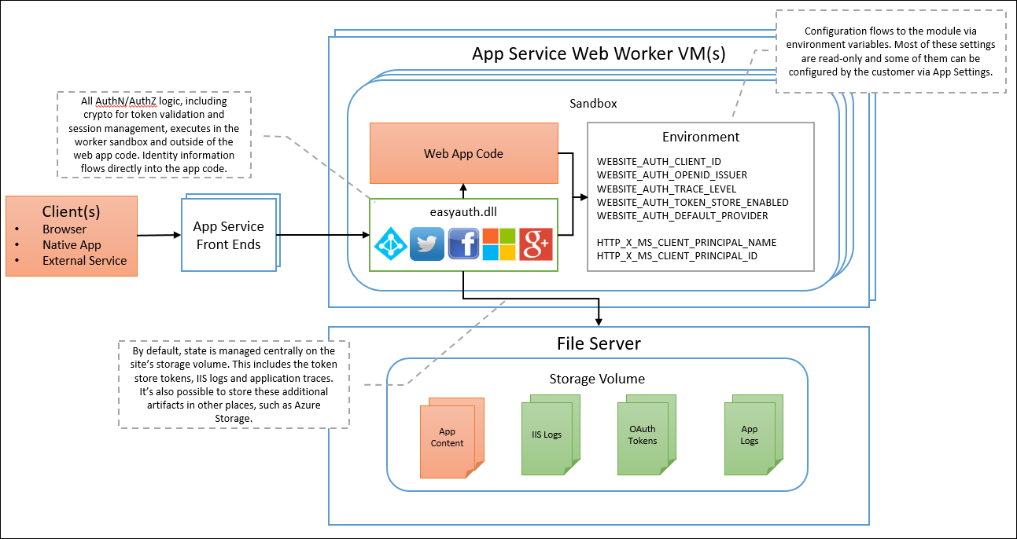
App Service Architecture

Slide 6
App Service Networking
Notes:
Frank will show the DevOps project: auto-scale, easy auth, CDN, clone
Demo the one that is already created.

Slide 7
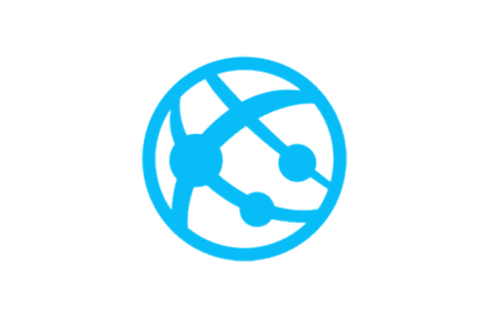
Default behavior
App Service
Inbound traffic to your app hits an IP address that is shared with the other apps.
Outbound backend calls from your app can only go out to the internet through a set of addresses shared with other apps. There are anywhere from 4 to 11 addresses used for outbound traffic
Internet

Slide 8

IP Restrictions
Scenario: Restrict access to your app at the web server. Can combine with app assigned address for a dedicated channel to your app.
This capability allows you to define a set of IP ranges that are allowed access to your app.
This capability is the same as the IP filtering capability seen in IIS. The filtering is enforced at the web server hosting your workload.
Secure network
Firewall
App Service
Internet
allowed
rejected

Slide 9

Hybrid Connections
Scenario: Access into networks lacking a VPN to Azure
Examples: Inventory management service that needs access into customer databases
Outbound backend calls from your app can reach TCP endpoints (host:port) in your any network that can access the internet.
Customer A
Internet
App Service
Customer B

Slide 10
VNet Integration
Scenario: Access resources in your Azure VNet
Example: Wordpress site with the database on a VM in your VNet
App Service
Azure Virtual Network
Internet
Outbound backend calls from your app can go to private IP addresses in your Azure Virtual Network or go out to the internet through a set of addresses shared with other apps.
You can reach on premises resources if VNet uses a Site to Site VPN to reach the on premises network. This does not work with ExpressRoute.

Slide 11
App Service w/ Traffic Manager
Notes:
Frank will show the DevOps project: auto-scale, easy auth, CDN, clone
Demo the one that is already created.

Slide 12

Fault-tolerant E-Commerce with personalized recommendations
Browser
CDN
East
Traffic Manager
West
Priority Traffic-Routing Method
Third party Payment
WebJob
Credit Card Processing
Queue
Credit Card Transactions
Commerce Site
Commerce Site
Queue
Credit Card Transactions
WebJob
Credit Card Processing
Third party Payment
Azure Active Directory B2C
Power BI
Search
Product Images
Site Content
Redis Cache
SQL Database
Product Catalog
Orders
Search
Product Images
Site Content
Redis Cache
SQL Database
Product Catalog
Orders
Application Insights
Power BI
Notes:
Configure Priority routing method
Configure Geographic routing method
Configure Weighted routing method
Configure Performance routing method

Slide 13

App Service
From on-premises to the cloud
AZURE APP SERVICE (MULTI-TENANT)
Get your Web, API, or Mobile App created in seconds in the cloud. We provide the infrastructure, you provide your application code.
APP SERVICE ENVIRONMENT
Run your apps in virtual network at high scale. Manage all of the resources behind your public endpoint creating an isolated environment specifically for your organization.
AZURE STACK
Leverage cloud innovations in on-premises infrastructure. App Service on Azure Stack brings the power of Azure App Service to your own data centers.

Slide 14



App Service Environment (ASE)
Scenario: Access resources in your Azure VNet
Example: Line of business sales application that is on a private IP address and uses SQL and Storage
ExpressRoute makes the Azure VNet a part of your on premises network. Access to your apps should be automatic unless blocked. By using
an ILB ASE you can host internal applications on the public cloud but isolated from the internet.
Azure Virtual Network
On Premises
ExpressRoute
App Service
Environment
Azure Storage
Service Endpoints
Azure SQL

Slide 15
Look at the thing
Notes:
Frank will show the DevOps project: auto-scale, easy auth, CDN, clone
Demo the one that is already created.

Slide 16
Thank you!
Notes:
Frank will show the DevOps project: auto-scale, easy auth, CDN, clone
Demo the one that is already created.

